Slide 1
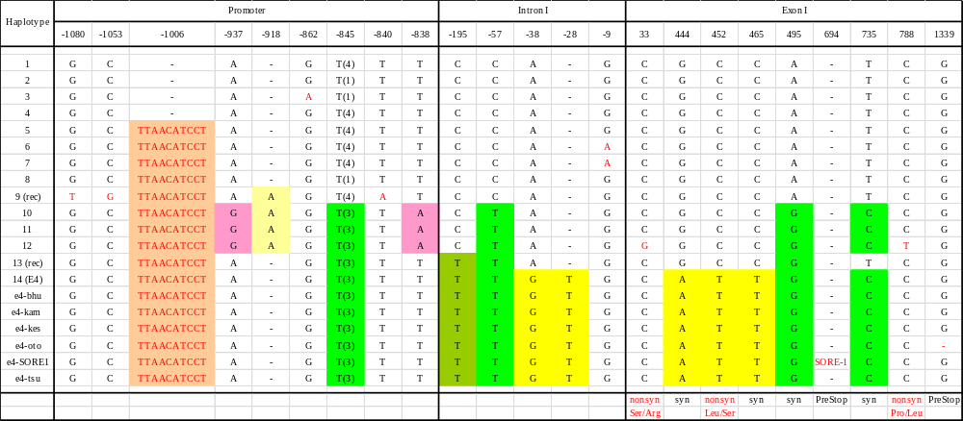
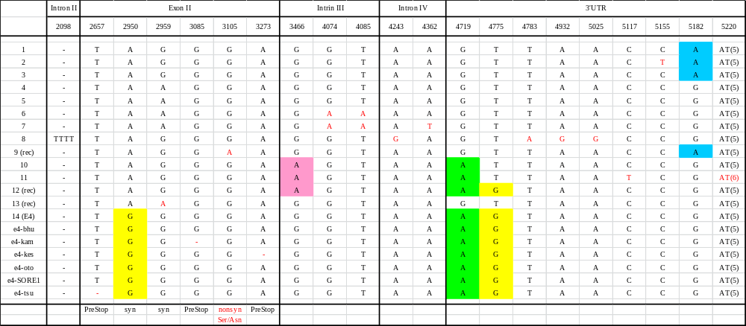
Supplemental figure S1. SNPs and indels in 20 haplotypes of E4 (GmphyA2) in 53 cultivated and 25 wild soybean accessions
syn and nonsyn; synonymous and nonsynonymous nucleotide substitutions
PreStop; premature stop codons generated by insertion or deletions

Slide 2
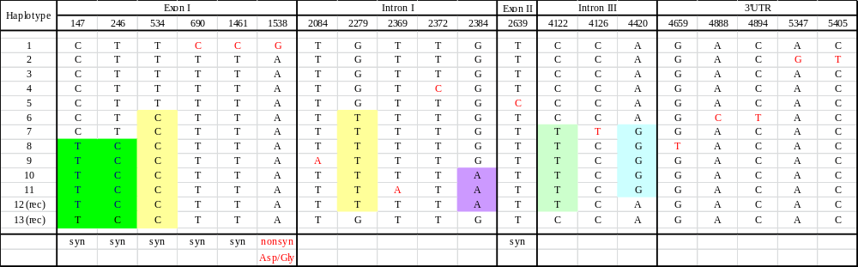
Supplemental figure S2. SNPs and indels in 13 haplotypes of GmphyA1 in 35 cultivated and 24 wild soybean accessions
syn and nonsyn; synonymous and nonsynonymous nucleotide substitutions

